Slide 1

OmniTrack: Orientation-aware RFID Tracking with Centimeter-level Accuracy
Chengkun Jiang, Yuan He, Xiaolong Zheng, Yunhao Liu
School of Software, Tsinghua University
System and Ubiquitous Networking (SUN) Group
http://www.thusunlab.cn/

Slide 2
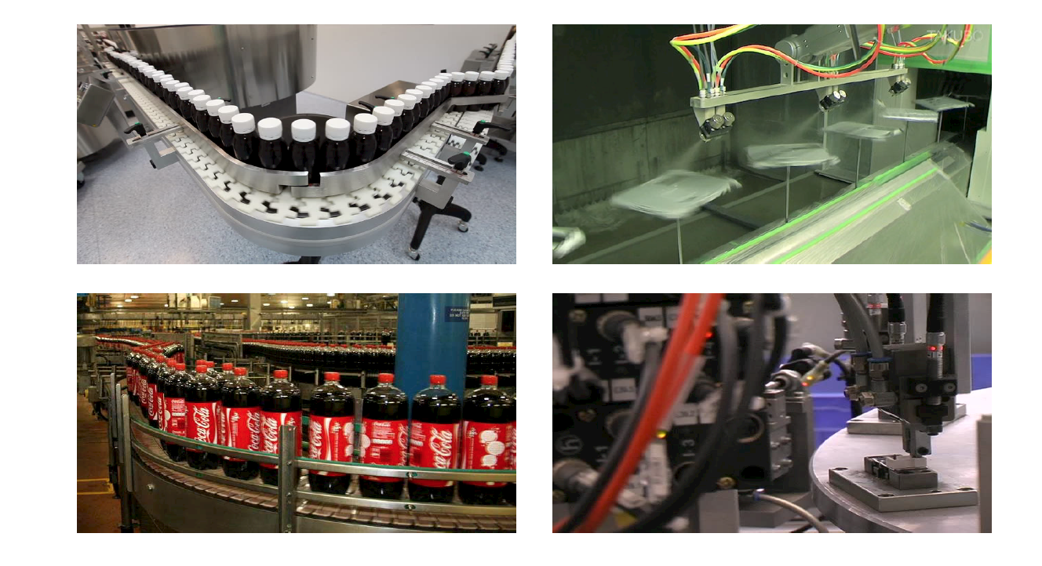
Background
Medicine bottle production line
Spray painting
Soda production line
Machining
Both the location and the orientation are important

Slide 3
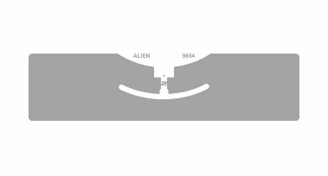
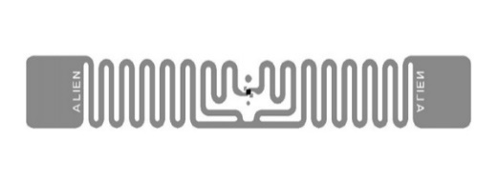
Background
RFID systems are suitable in tracking the moving targets
Existing RFID tracking systems can exploit the phase values to achieve high accuracy
These works don’t explicitly deal with the orientation change of the target
The orientation can affect the measured phase value

Slide 4
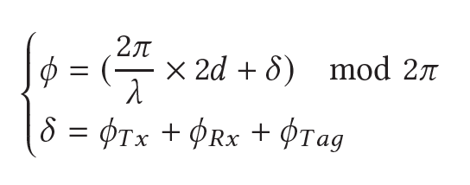
Observation
Orientation-oblivious phase model
Existing works can cause large errors in the scenarios with orientation change

Slide 5
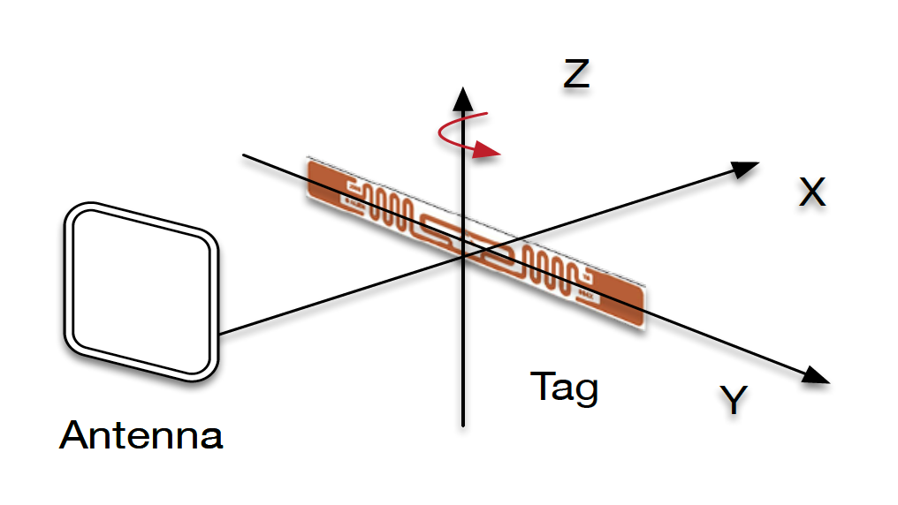
Observation
Observation: The measured phase will change linearly with the angle between the polarized direction of the tag and the antenna-to-tag direction.

Slide 6
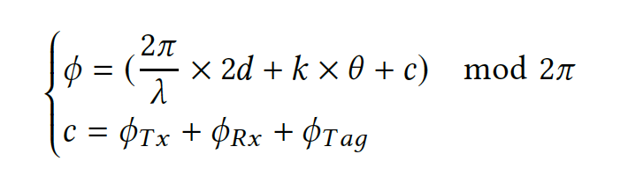
Observation
Orientation-aware
phase model

Slide 7
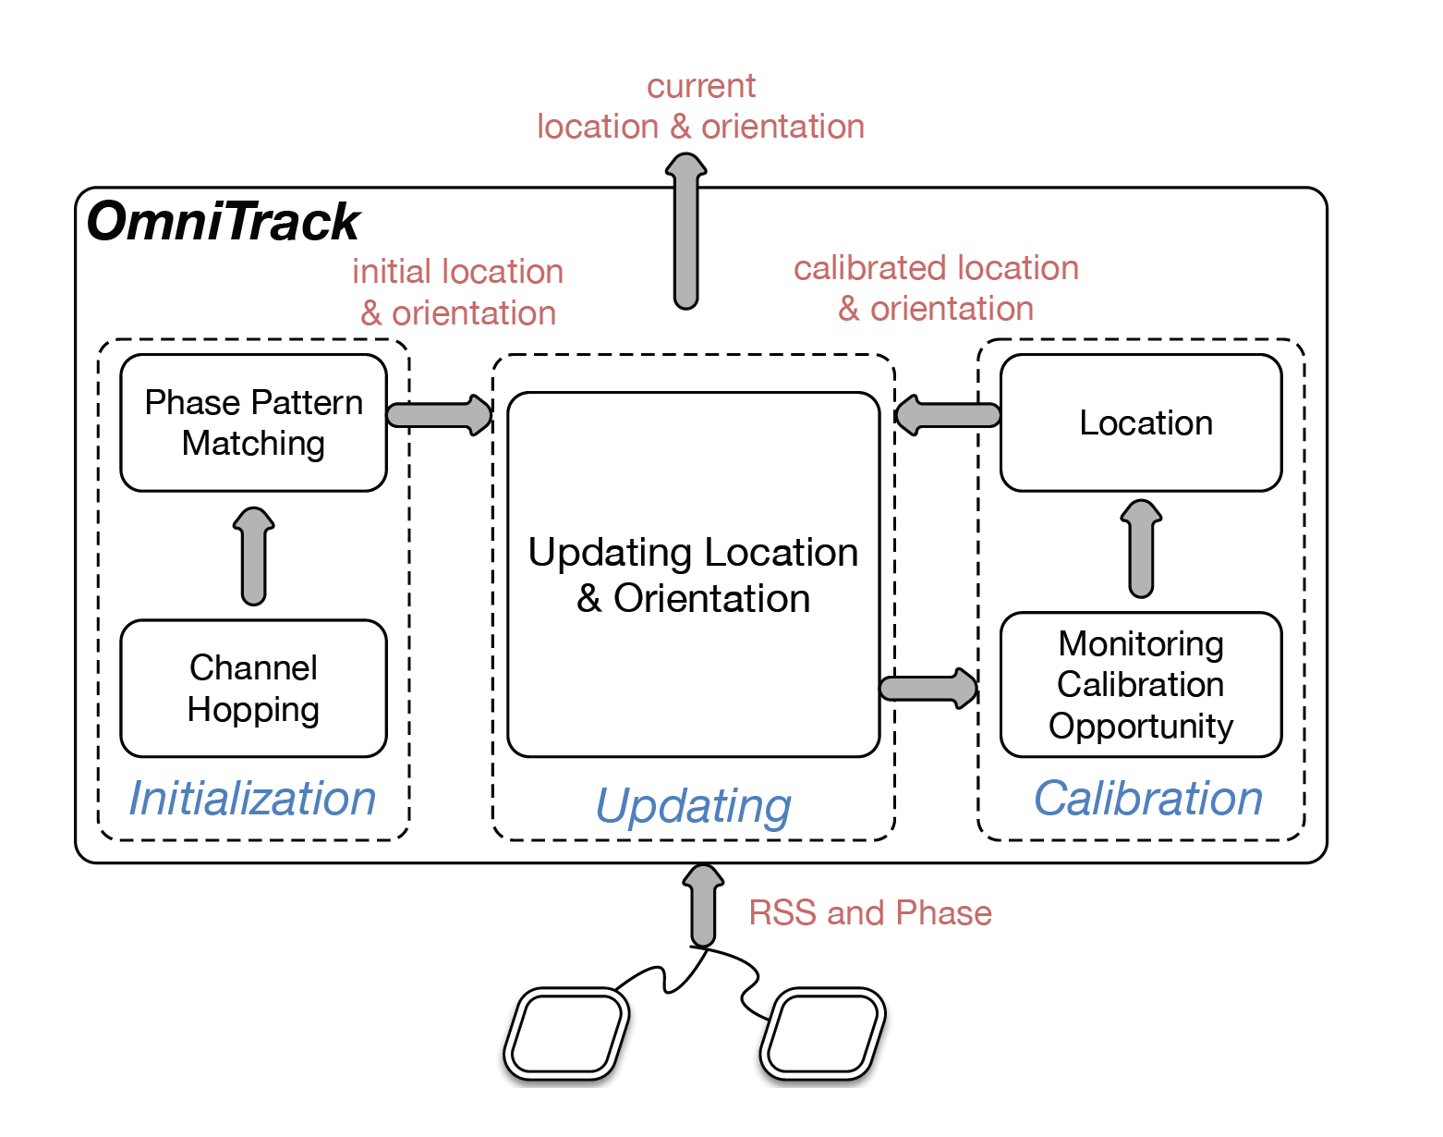
Design
Initialization: Providing the initial location and orientation
Updating: Iteratively updating the tag’s location and orientation
Calibration: Dealing with the error accumulation

Slide 8


Updating
Antenna $A_{1}$
Antenna $A_{2}$

Slide 9
Updating
Antenna $A_{1}$
Antenna $A_{2}$

Slide 10


Updating
Phase difference for $A_{1}$
Phase difference for $A_{2}$

Slide 11
Updating
We could have the distance difference from the tag to two antennas

Slide 12
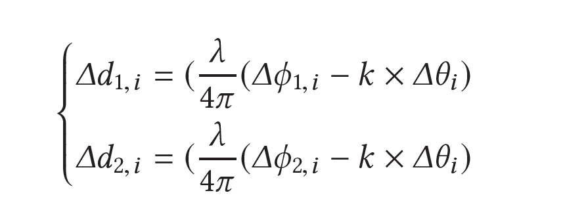
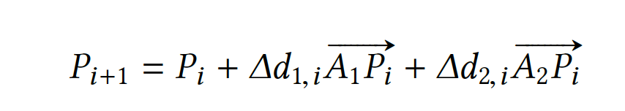
Updating
Moving distances along two directions

Slide 13
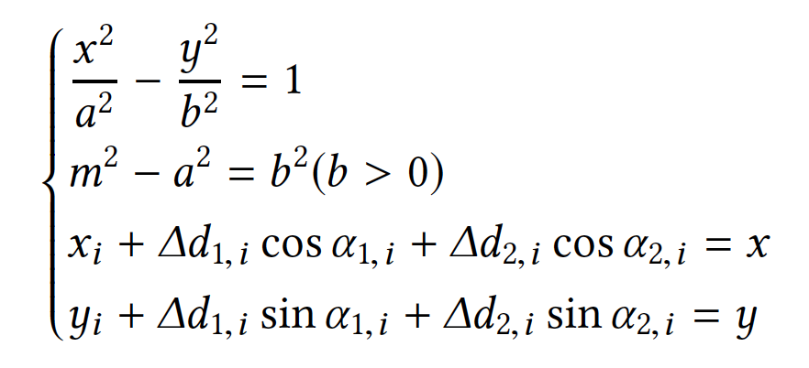
Updating
It turns out to solve an equation set

Slide 14

Initialization
Obtaining the hyperbola in which the tag is located
Pinpointing the tag with the angle
Channel Hopping
Calculating the distance difference
Pattern Matching
Finding the $∆θ$

Slide 15
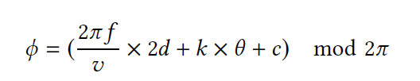
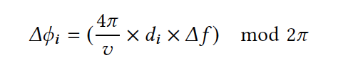
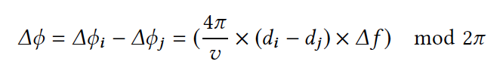
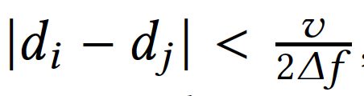
Initialization
Obtaining the hyperbola in which the tag is located
Pinpointing the tag with the angle
Really large number

Slide 16
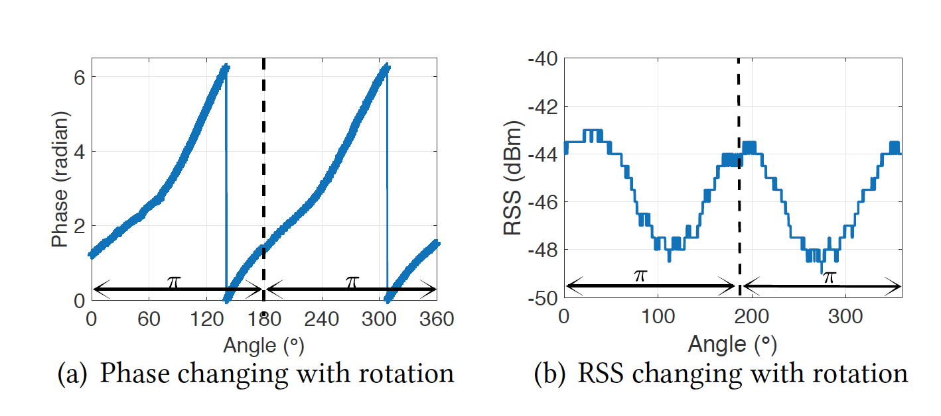
Initialization
Obtaining the hyperbola in which the tag is located
Pinpointing the tag with the angle
Rotating the tag to find the phases corresponding to two lowest RSS

Slide 17
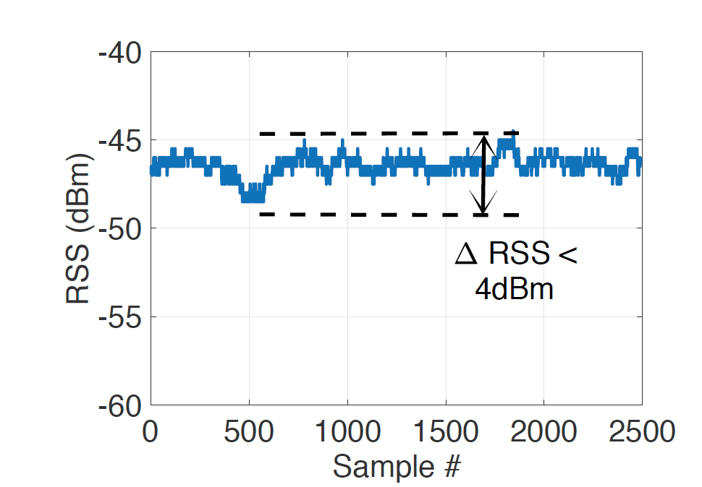
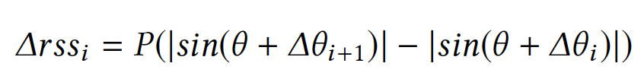
Calibration
Iteratively updating the location and the orientation causes error accumulation
Finding the calibration interval for the orientation calibration
Calibration Interval: Rotation is the main movement
Searching the angle that satisfies the RSS change best

Slide 18
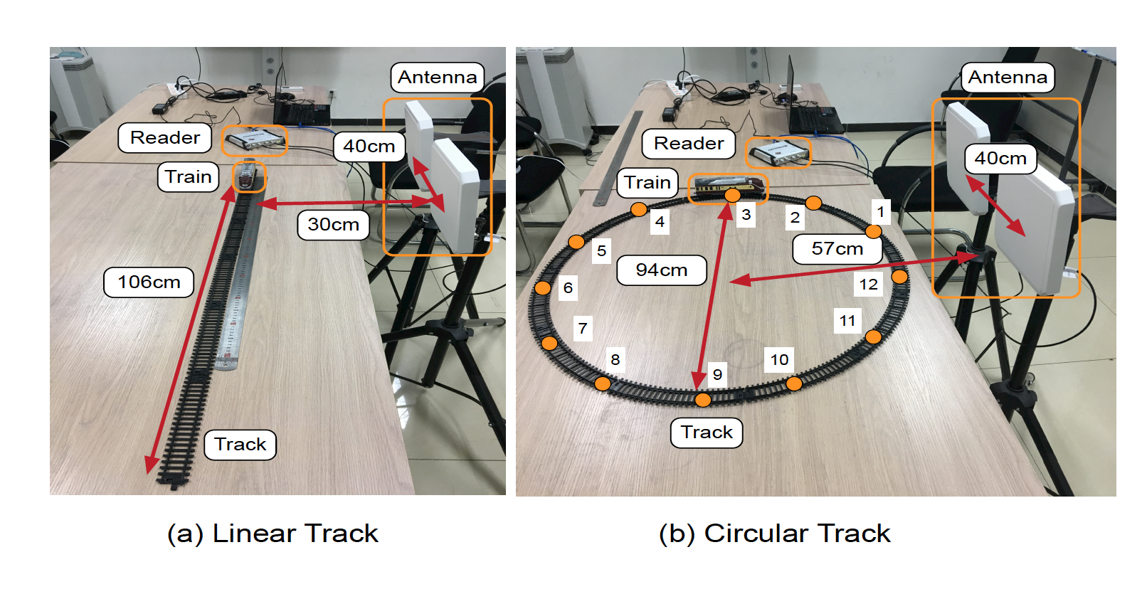
Implementation
Hardware
Impinj R420 RFID reader
Circular-polarized antenna
COTS RFID Tags
Tagoram
BackPos

Slide 19
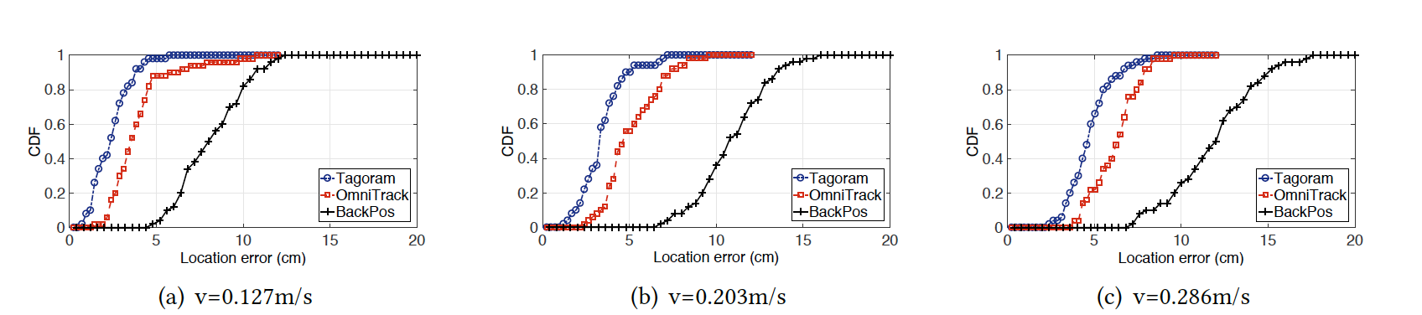
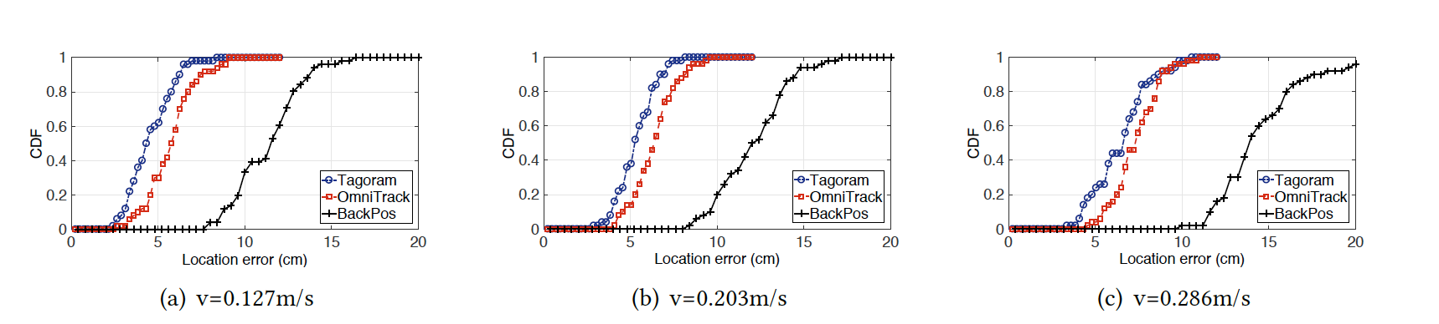
Evaluation (without rotation)
Location error on the linear rail
Location error on circular rail

Slide 20
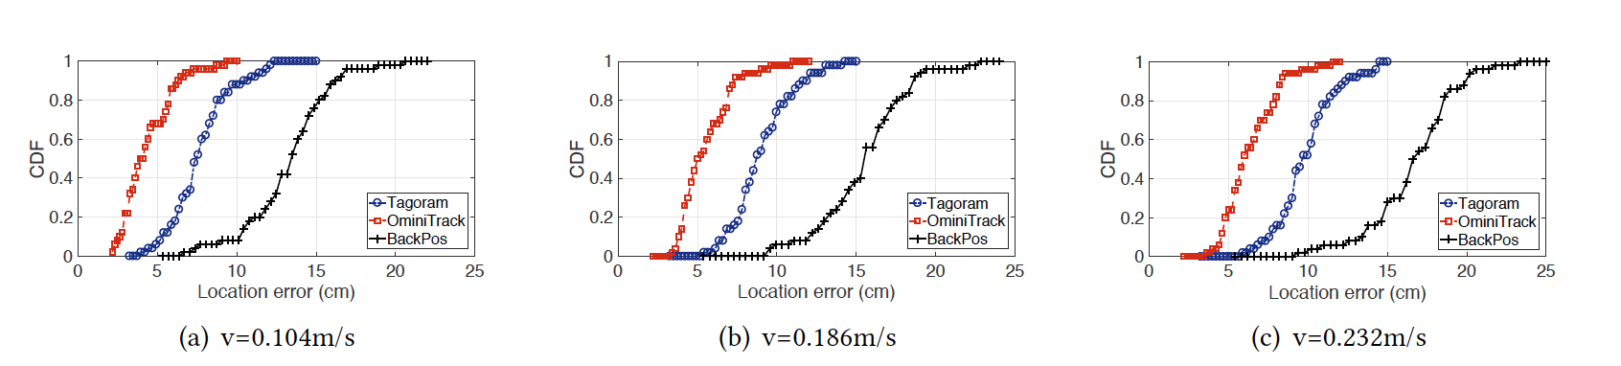
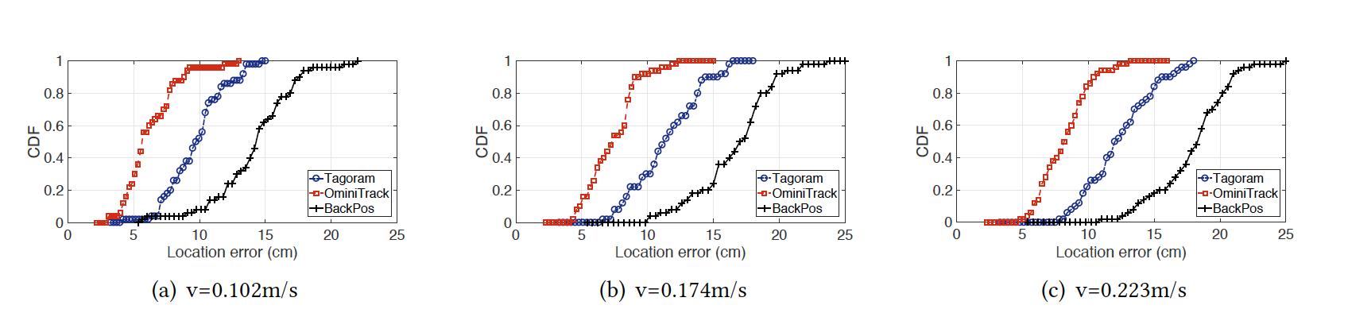
Evaluation (with rotation)
Location error on the straight rail
Location error on the S-shape rail

Slide 21
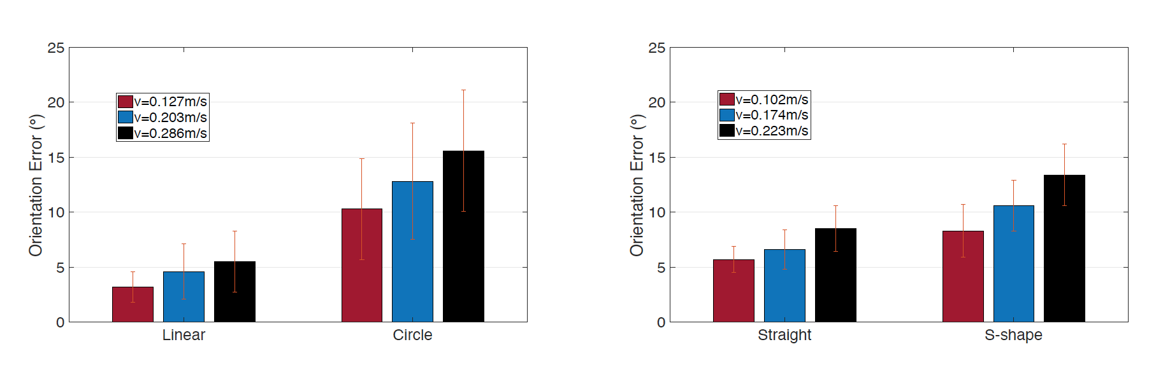
Evaluation
Orientation error without rotation
Orientation error with rotation

Slide 22
Conclusion
We propose OmniTrack, an orientation-aware RFID tracking approach that is applicable to COTS RFID systems.
Unlike the existing phase-based proposals, OmniTrack employs an orientation-aware phase model for target tracking and efficiently deals with various orientation-dependent problems.

Slide 23
Thanks! Q & A

